Slide 1
Credit card default
by
Sushmitha Kappala
Abhishek Mohanty
Syed Hayath Yaseen
Mohammed Sameer Ahmed
Matcha Sai Akhil

Slide 2
Life cycle of project
Data
Business Understanding
Data Understanding
Data Preparation & EDA
Feature Engineering & Feature Extraction
Model Building
Model
Evaluation

Slide 3
Business Understanding
Overview:
Financial threats are displaying a trend about the credit risk of commercial banks as the incredible improvement in the financial industry has arisen. Credit card has been one of the most booming financial services by banks over the past years. In this way, one of the biggest threats faces by commercial banks is the risk prediction of credit clients.

Slide 4
Data understanding
ID
LIMIT_BAL
SEX
EDUCATION
MARRIAGE
AGE
PAY_0
PAY_2
PAY_3
PAY_4
PAY_5
PAY_6
BILL_AMT1
BILL_AMT2
BILL_AMT3
BILL_AMT4
BILL_AMT5
BILL_AMT6
PAY_AMT1
PAY_AMT2
PAY_AMT3
PAY_AMT4
PAY_AMT5
PAY_AMT6
INDEPENDENT
VARIABLES
(PREDICTORS)
-24
DEFAULT PAYMENT NEXT MONTH
DEPENDENT/TARGET VARIABLE

Slide 5
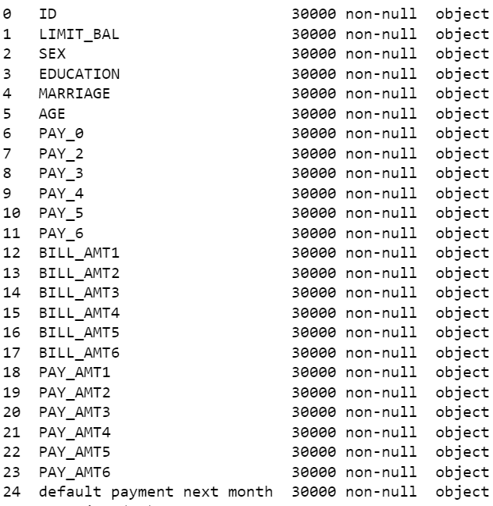
Variable information | Missing values
Number of records : 30000
Number of variables: 25
No missing values
Initially all the variables are in object type
Type casted to required datatype

Slide 6
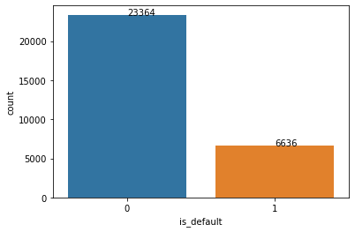
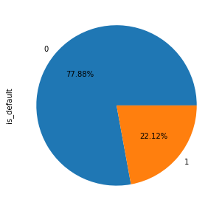
Univariate analysis DEFAULT PAYMENT NEXT MONTH (Target variable)
Default payment (1=yes, 0=no)
Imbalance in the data
Probability of getting default is 0.22

Slide 7
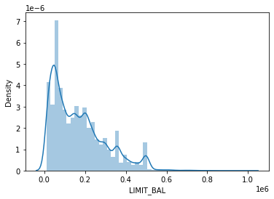
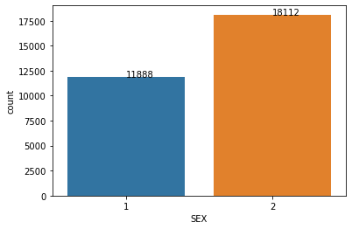
LIMIT BALANCE | SEX
Moderately right skewed
Some peaks in the distribution
Extreme values
Min-10000 , Max-1000000
Male -40% Female -60%

Slide 8
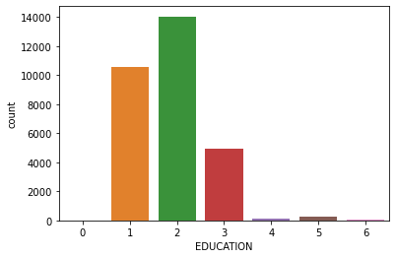
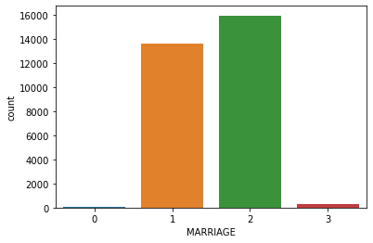
Education | marriage
1=graduate school, 2=university, 3=high school
5 & 6 – labelled as Unknown
0 is undocumented
1=married, 2=single, 3=others
0 is undocumented

Slide 9
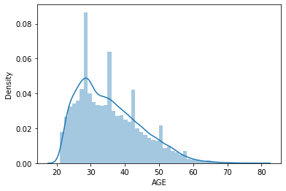
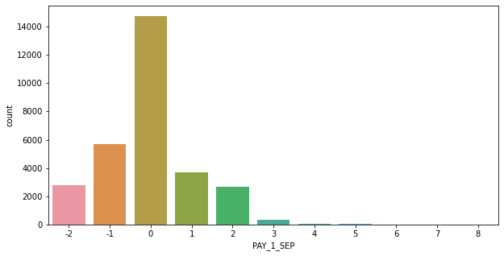
Age (In years) | pay_x (X=0,2,3,4,5,6)
Moderately right skewed
Peaks in the distribution
Only few customers with 4+ months of delay
From 2 to 8 count is in decreasing manner
Distribution is nearly same for all the PAY_X features

Slide 10
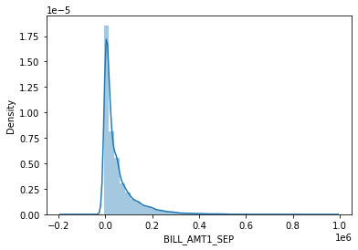
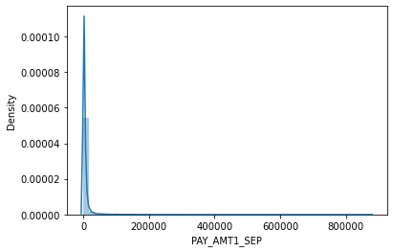
Bill_AMTX (X=1,2,3,4,5,6) | PAY_AMTX (X=1,2,3,4,5,6)
Distribution is nearly same for all the 6 bill amount features
More clients are in the range (0-100000)
Distribution is nearly same for all the 6 pay amount features
Around 75% of clients pay amount is below 5000

Slide 11
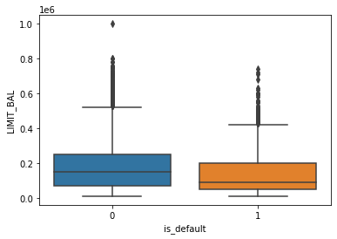
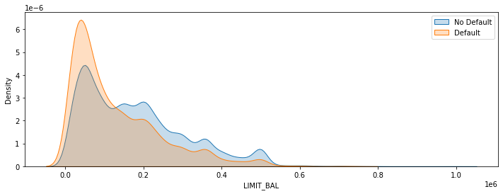
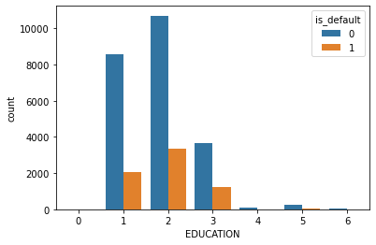
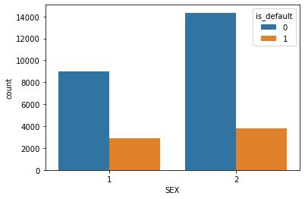
Bivariate analysis

Slide 12
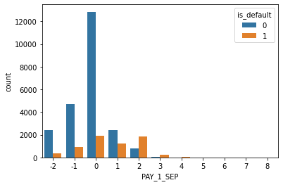
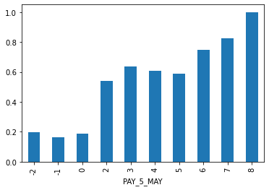
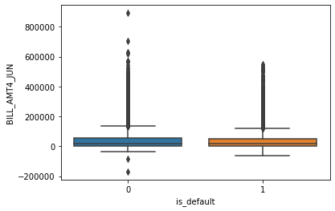
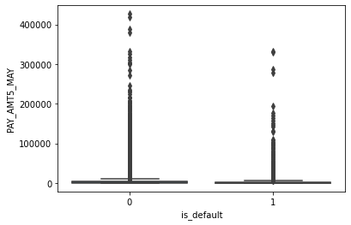

Slide 13
Insights from bivariate analysis
In the range of (0 to 100000) defaulters more than non-defaulters
After 500000 defaulters count is very less compared to non-defaulters
Average limit balance of default class is less than the average of non-default class by around 48000
Limit balance is high for the clients who pay duly
24.17% of men are defaulters and 20.78% women are defaulters
Men have higher chance of default than women
Probability of default for married is higher than single
Most of the customers pay duly, probability of default is much low
The earlier the payment is made lesser are the chances of those clients defaulting the payment

Slide 14
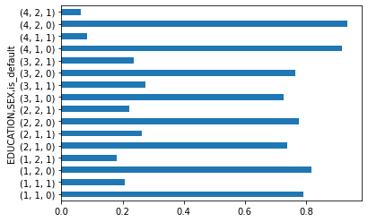
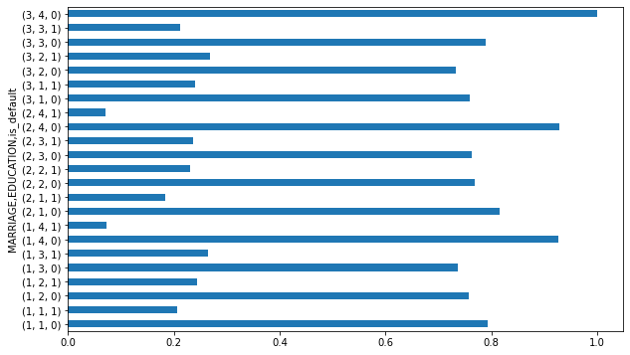
Multivariate analysis
MARRIAGE: 1=married, 2=single, 3=others
EDUCATION: 1=graduate school, 2=university, 3=high school
EDUCATION-SEX-IS_DEFAULT
MARRIAGE-EDUCATION-DEFAULT

Slide 15
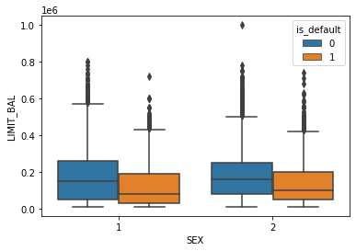
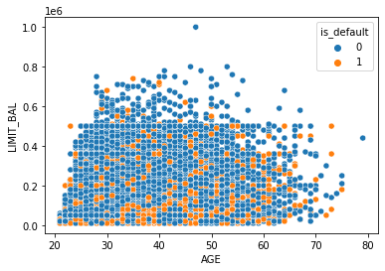
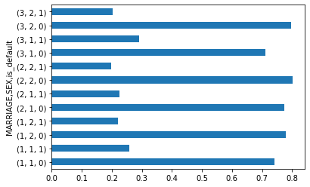
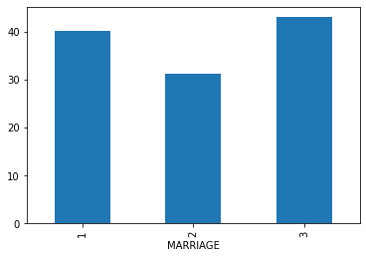
Marriage-sex-isdefault
Marriage-age-prob(default)

Slide 16
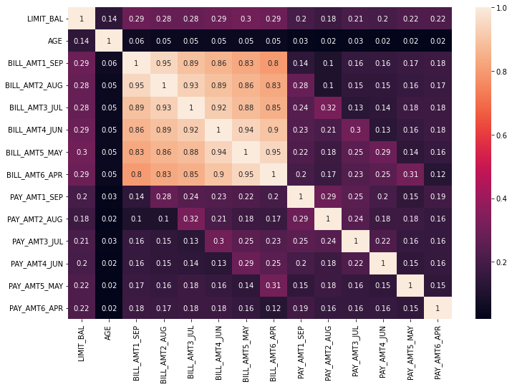
HEAT MAP

Slide 17
Insights from multivariate analysis
Both for male and female median value limit balance or defaulter is lower than non-defaulter
In all the education sectors, the probability of default was higher for men
Probability of educated people who got married being default is 0.22
Probability of educated people who are single being default is 0.21
Probability of others (educated) being default is more than married and single
Who (male/female) have low limit balance are more likely to default
Average age of male being default is 36 years and for the female is 34 years
In all the marriage categories, probability of male being default is high.

Slide 18
Feature engineering
Created a new feature AGE BINS using AGE variable
Created 5 more new features [due1, due2, due3, due4, due5]
By taking the difference between the every month bill amount and successive month pay amount
Created one more feature PAYMENT VALUE by adding all PAY_X features

Slide 19
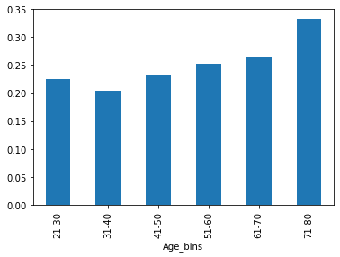
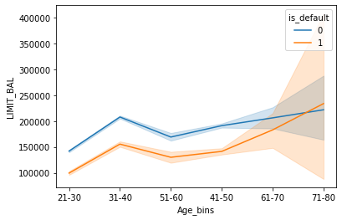
From 41 to 80, the defaulters increase with increase in age and limit balance
Probability of being default increases with increase in age group
Mean payment value for defaulters is around 2 and for non-defaulters is -2
Mean values for all dues is more for defaultes than non-defaulters

Slide 20
Feature selection
Statistical Tests :
2-sample Independent T-test : For Numerical vs Categorical variables
Chi-square contingency : For Categorical vs Categorical variables
Results from the statistical tests :
Significant Variables count - 20
Insignificant Variables count - 3

Slide 21
DATA preparation
ID variable removed from the data
0,5,6 are replaced with 4 (others) in the EDUCATION column
0 replaced with 3 (others) in the MARRIAGE column
Scaling Technique : Standard Scaler applied on the numerical variables
Transformation : Yeo-Johnson method
Encoding : Dummy Encoding on Categorical data
Splitting the data : Data has split into train and test set in 70:30 ratio
SMOTE technique has used to balance the imbalanced data

Slide 22
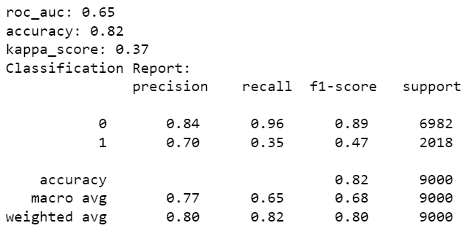

Base model – logistic regression (before smote)
Confusion Matrix:

Slide 23
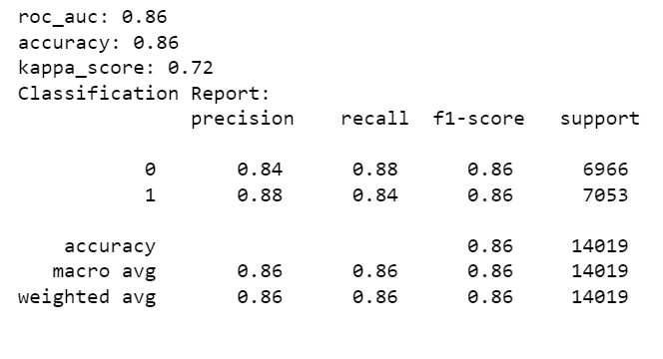
Final Model– Voting Classifier (post smote)
Accuracy score increased from 82% to 86%
Roc-auc score increased from 0.65 to 0.86
Recall_1 increased from 0.35 to 0.84
Kappa score increased from 0.37 to 0.72

Slide 24
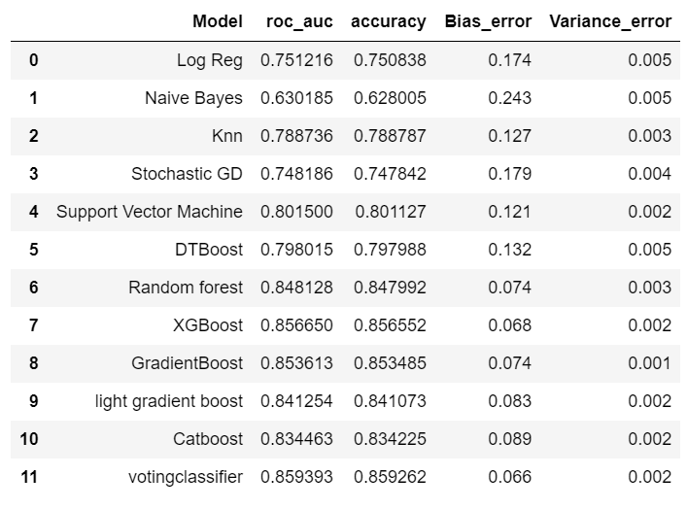
Model comparison

Slide 25
Business recommendations
Improve the construction of the credit indicator system. A good credit index system is conducive to better assessment of personal credit.
Focus on the clients whose payments are in delay for more than 2 months
From the EDA as well as from the model feature importance, features which are related to bill and pay amounts (includes dues), pay values and limit balance plays a key role in predicting the target variable
So by considering all the significant features influencing the default, improve the process of evaluating the person while approving the credit

Slide 26
summary
Data Analysis has done on all the features to get the insights and to know the influence of those on target variable
Created 7 new features using feature engineering technique
SMOTE technique has used to balance the data
Statistical tests has been performed on all the variables
So many Linear and Non-linear models have built to get the model which classifies the target variable better
Used hyper tuning, bagging, boosting, stacking techniques to improve the prediction
performance of the model

Slide 27

Thank you

